Slide 1
2019 Alberta Career Development Conference
N.E.A.A.I./Tiny Homes Project
May 1, 2019
Developed by:
TRIBAL CHIEFS EMPLOYMENT & TRAINING SERVICES ASSOCIATION (TCETSA)

Slide 2
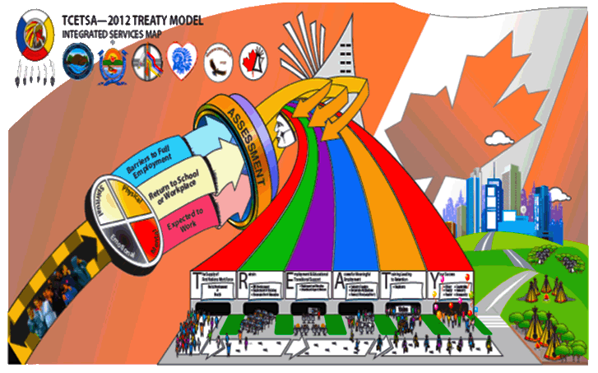
TRIBAL CHIEFS EMPLOYMENT & TRAINING SERVICES ASSOCIATION
Incorporated under Societies Act in 2000
Staffing:
TCETSA – Edmonton – 4 Staff
TCETSA – St. Paul – 1 Staff
NEAAI – 8 Staff
Xpressions – 1 Staff
Sub-Agreement Holders:
Technicians - 6
Daycare Directors - 6
TCETSA BOARD MEMBERS
6 Board of Directors
Current Funding Agreements: GOC, GOA, Sub contracts with 6 TCV Nations
ISETP Funding to Sub-Agreement Holders for Employment & Training & Daycares
Other Projects:
Employment & Training
Edmonton Urban
Small Urban
BLCN, CLFN, FLFN, HLFN, KCN, WLFN
NEAAI/TINY HOME
Goal #1: To increase the number of Journeymen in NE Alberta.
Goal #2: Increase employment outcomes
Goal #3: To provide hands on Apprenticeship training during the construction of a Tiny Home
Goal #4: Providing mentoring supports and increased employment outcomes for job seekers
Goal #5: Provide an In-House Safety Instructor to the TCV Nations
CLIMATE CHANGE
Goal #1: To provide hands on training to complement the In-Class room portion of training
Goal #2: Develop a Solar Training Programs for TCV Members. This will be incorporated into the 1st Period Carpentry Program that is being developed in partnership a local service provider
Goal #3: Identify and implement climate Capacity training for Nation members
XPRESSIONS
Goal #1: Created to engage, support and train TCV member Nation Artists
Goal #2: Artists to return to School for further training
Goal #3: Artists to secure full-time employment upon completion of Xpression’s Program
Goal #4: TCETSA to assist with on-going marketing support to Artists through a co-op approach
OTHER/PROPOSED PROJECTS
Cultural Showcase Event
Explore various Technology Training Programs
Explore Driverless Shuttle Opportunities
Office Procedures Training
Development of Indigenous Business Directory
First Nations Labour Market Survey
CLFN, FLFN, HLFN &WLFN
Daycares
BLCN, CLFN, FLFN, HLFN, KCN, WLFN

Slide 3
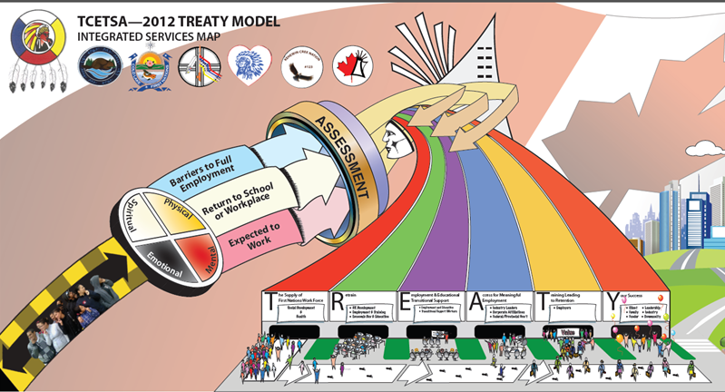
T.R.E.A.T.Y. Model Process
Notes:
Any program developed through Tribal Chiefs Employment & Training Services uses the holistic approach to community enhancement using the TREATY Model approach.
T – The Supply of Workforce
R – Retrain
E – Employment Transitional Supports
A – Access to meaningful employment
T – Training leading to retention
Y – Your Success

Slide 4
History, est. 2013
In response to the current and projected skilled labor shortages in Alberta, N.E.A.A.I., utilizes a blended distance learning environment and support system with the objective of increasing the skilled workforce in Northeast Alberta.
Solution: More apprentices becoming indentured and entering the skilled trades workforce.
Support
Training
SOLUTION!
Skilled Worker Shortage
Notes:
Designed to meet the estimated 20,000 Tradesman shortages expected by the year 2020.
Baby Boomers retiring and need to replace with new Apprentices.
Indigenous population has one of the highest youth populations with 60 % between the ages of 16 to 30 years of age.

Slide 5
“Closing the Gap”
North East Alberta Apprenticeship Initiative
VISION STATEMENT:
To increase the number of Aboriginal and Non Aboriginal apprentices participating in all trades and completing the requirements to Journeyman status.
MISSION STATEMENT:
To develop a skilled workforce to benefit the skilled shortages predicted in the Alberta economy by developing, maintaining and sustaining positive working relationships and strategizing with all Stakeholders to ensure this process.

Slide 6
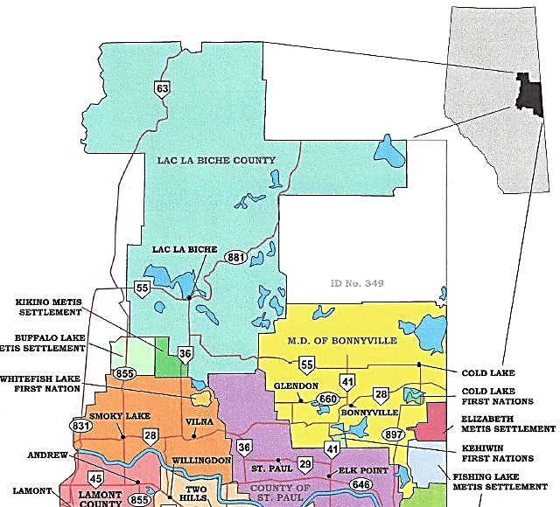
Our Service Area:

Slide 7
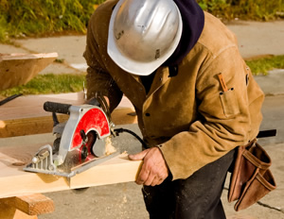
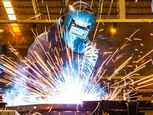
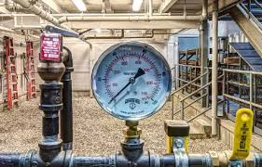
NEAAI delivers:
Apprenticeship recruitment
Support coaching
Tutoring Services
Employment Services
Training navigation for trade’s people in northeastern Alberta
Class 7 Learners Training
Relationships are being developed with:
Industries
Businesses
Communities
Apprenticeship
Industry Training Offices (AIT)
Colleges, and communities with in the Northeast region.

Slide 8
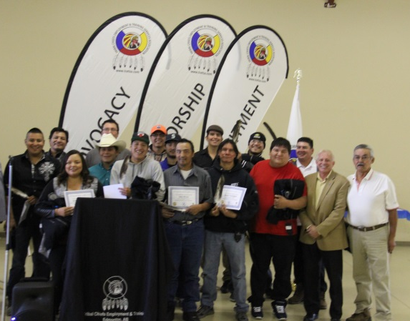
The Client
The client is not an outsider to our business. He is part of our business.
He is not an interruption of our work.
He is the purpose of it.
We are not doing him a favour by serving him.
He is doing us a favour by giving us the opportunity to do so.
The client is not a cold statistic.
He is a flesh and blood human being with feelings and emotions like our own and with biases and prejudices.
He is the most important visitor in our office –
whether he comes in person or by mail or over the telephone.

Slide 9
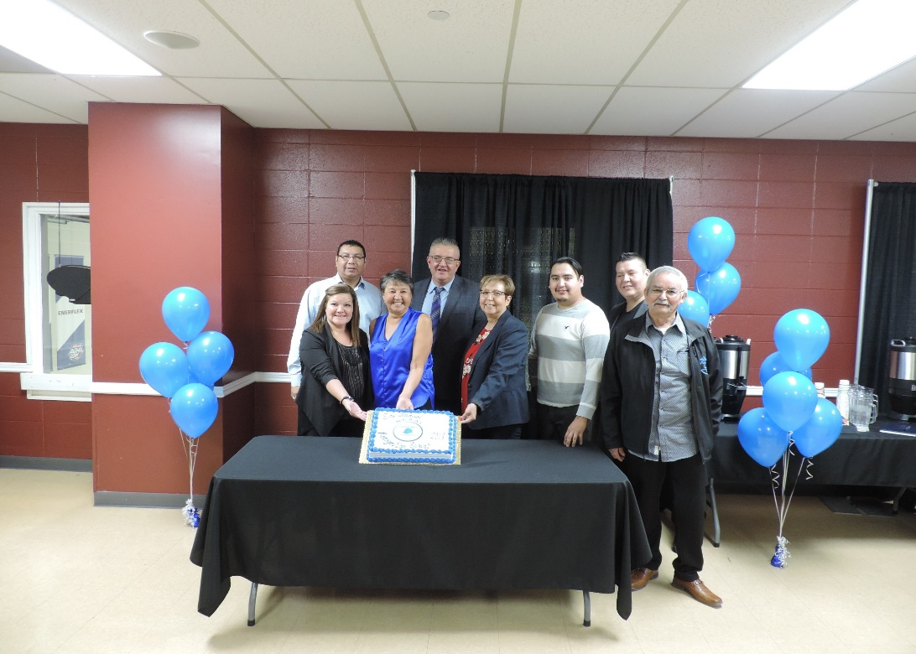
NEAAI STAFFING
8 full time staff members work within the North East Alberta region to continuously engage with individuals seeking apprenticeship opportunities, employers seeking engagement of apprentices, Alberta Industry Training, training centers, and the Indigenous communities.
NEAAI staff share apprenticeship information.
Services can be provided to anyone seeking information.
Notes:
NEAAI is guided by the participation of partner organizations through their representatives at stakeholder meetings and on the Steering Committee.
The Steering Committee oversees the initiative on a regular basis and provides information and advice from the respective partners and helps identify the opportunities and challenges for placement of apprentices through shared interests, information, promotion and decision making.
The Steering Committee meets on Quarterly.

Slide 10
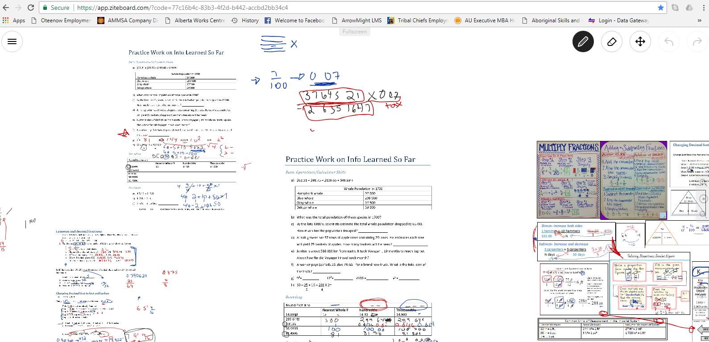
ON-GOING TUTORING SUPPORTS
Tutoring is offered to our clients free of charge and at their convenience, including evenings and weekends.
Trade specific Math and Science concepts are taught using distance learning technology.
Help is available from the entrance exam to technical school and Red Seal.
Resources like online practice exams, and Skype help build the tutoring service as accessible, useful, and as clients mention “very helpful”.
Ziteboard.com
Notes:
Trades Tutor works out of the TCE&TSA office in Edmonton, Alberta. Tutor will adjust her work schedule to assist the client.
Clients must have access to the Internet and Skype

Slide 11
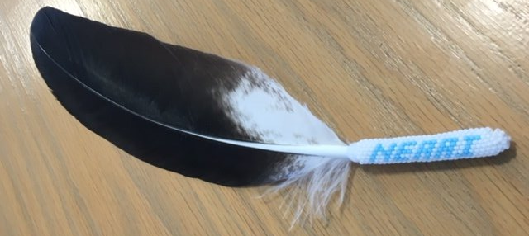
Recognition Event
Held Annually, NEAAI recognizes each client who moves from one year to the next in their prospective trade and honors those who reach Journeyperson status.
Clients are presented with an eagle feather for their hard work, which in Indigenous Culture, is a huge representation of respect.
Notes:
The Eagle Feather
The eagle is a winged symbol for the Indigenous people because it is seen as the strongest and bravest of all birds. For this reason, the eagle and its feathers have been chosen as a symbol of what is highest, bravest, strongest and holiest. An eagle’s feathers are treated with great respect and given to another in honor. They are worn with dignity and pride.
When the feathers are held over someone’s Head it means the person is brave or it wished bravery and happiness. To wave it over everyone present means everyone is wished Peace, Prosperity and Happiness.

Slide 12
Partnership Map
Notes:
Requirements:
Minimum age of 18 years old.
Completed Grade 10 Math, Science and English.
Access funding for a Living Allowance.

Slide 13
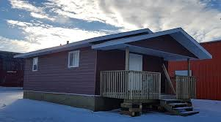
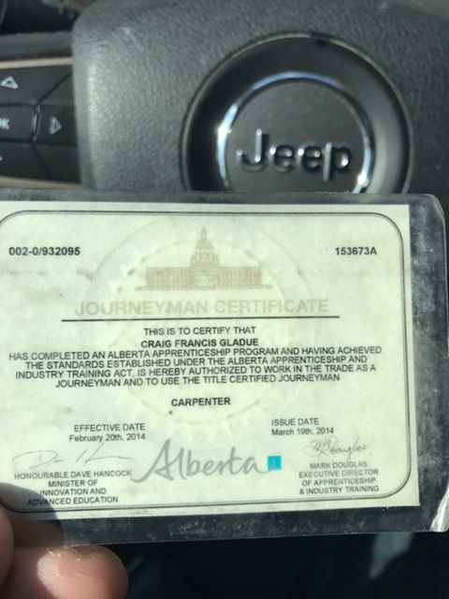
Tiny Homes Project est. Aug 2016
Under the direction of a Journeyman Carpenter, Journeyman Plumber and Journeyman Electrician this holistic home building project is aimed at addressing the needs of the trainees in construction safety, trades training and hands-on work experience.
Total Hands-On Estimated
Hours:
Carpentry - 210
Electrical - 50
Plumbing - 50

Slide 14
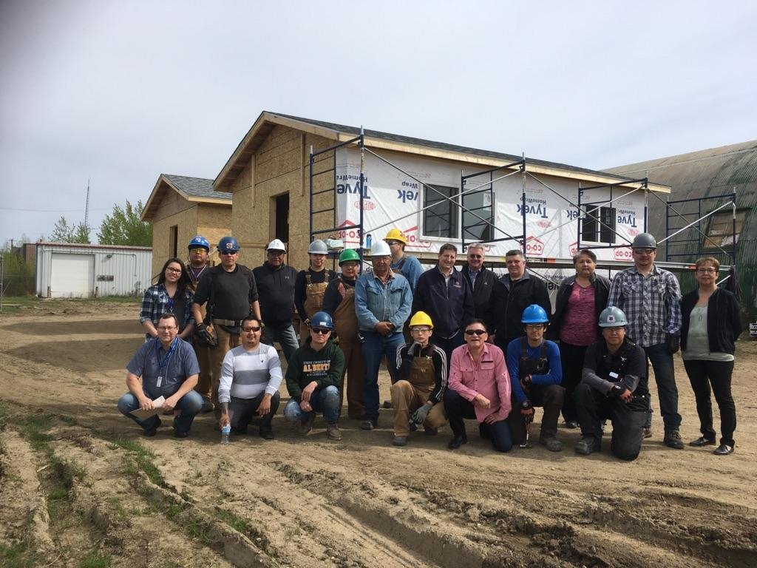
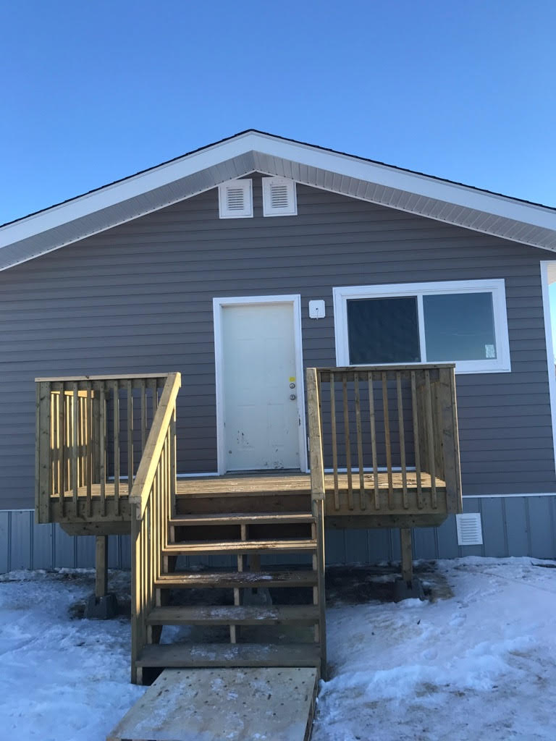
“Innovation, Collaboration, and Coordination”
To date N.E.A.A.I. has had 71 participants in the Tiny Home Project.
Tiny Home Projects done at 7 communities:
CLFN, KCN, WFLFN, BLCN, HLFN, SLCN, KMS

Slide 15
Health & Safety
Sample

Slide 18
What do we offer to the Employer?
Access to skilled workers in every field from Trades to Non-Trades.
Pre-employment readiness assessments
Tutoring free of charge to employees
Mentorship to employees/employers to navigate the trades process

Slide 19
CURRENT NEAAI STATS:
North East Alberta Apprenticeship Initiative
Statistics for March 2019
 | Indentured | 47
 | Non-Trade | 125
 | Journeyman | 27
 | Closed | 432
STATISTICS BY TRADE:
 | 1st | 2nd | 3rd | 4th
Auto Service Tech. | 1 |  |  |  | 1
Baker | 1 |  |  |  | 1
Carpenter | 7 |  | 3 |  | 10
Electrician | 1 | 4 | 3 | 3 | 11
Hairstylist | 2 |  |  |  | 2
HET | 3 | 2 | 1 |  | 6
Industrial Mechanic-Millwright | 1 |  |  |  | 1
Instrument Tech. |  |  | 1 |  | 1
Insulator |  | 1 |  |  | 1
Ironworker | 2 |  |  |  | 2
Parts Technician |  |  |  |  | 0
Plumber/Gasfitter | 5 | 1 |  |  | 6
Sprinkler Systems Installer | 1 |  |  |  | 1
Steamfitter/Pipefitter | 2 |  |  |  | 2
Welder |  | 1 | 1 |  | 2
Totals: | 26 | 9 | 9 | 3 | 47
Notes:
The Stats change accordingly to the Economic forecast. At this time the Economy is slow and looking at innovative ways to create Trades opportunities.

Slide 20
NEAAI Initiatives
An Apprenticeship Program Partnership commenced with Primco Dene to indenture 12-12 Cooks and Bakers. The Primco Dene kitchens are now registered with AIT and have the ability to credit hours.
Continue to work with local employers in Cold Lake and Bonnyville, such as Arrowhead Industrial and Seven Lake Oilfield Service, in order to set up other Apprenticeship programs and apply for AIT recognition.

Slide 21
Success Stories
Kevin Amahoose
Journeyman Electrician
“Every time I failed I didn’t give up. It just pushed me more to try again because I believe that true success is found in not giving up.”
Kevin is from Kehewin Cree Nation. He is currently working on getting his Red Seal Certification and recently started his own business called Amahoose Electric.

Slide 22
Jeremy Berube
Journeyman Welder
Jeremy was recently recognized as completing his program and the following is a story as told by his liaison worker.
“He gave me a copy of his Journeyman Certificate and I presented him with his eagle feather and coat. His coat was a perfect fit by the way. He then began to express to me how important it was to him and how much it meant to receive an award like the one I gave to him this morning. As he sat and admired his award I noticed tears were rolling down his cheeks. I extended my hand to congratulate him once more and he pushed it aside and pulled me in for a hug. This will be a constant reminder for me to carry on and help others reach this milestone and I wanted to share this with you.”

Slide 23
Lyndsey Beaunoyer
Journeywoman Instrumentation Technician and 2nd Year Electrician
Lyndsey is Metis from the Red River Metis Settlement in Southern Manitoba but lives in the Bonnyville/Cold Lake Area.
At 17, she took the pre-employment Instrumentation course at Lakeland College in Vermilion, AB. She did a placement with Pyramid and eventually became indentured in Instrumentation Tech. She worked for 3 ½ years until the Oil and Gas economy crashed and she was laid off.
She then approached NEAAI who helped her during her fourth year to get certified as a Journeywoman. Then in 2017 she got into the NIP program at Imperial Oil where she got indentured as an electrician. She challenged her 1st and 2nd Year Electrician trade in the same month and at present is working on her practical hours for 2nd Year.
She aspires to get the Red Seal for both trades.

Slide 24
CONTACT INFORMATION
T.C.E.T.S.A.
17533 106 Ave
Edmonton, AB
T5S 1E7
(780) 481-8585
N.E.A.A.I.
6003- 47 Ave
Bonnyville, AB
T9N 0B3
(780) 812-6672
www.tcetsa.ca

Slide 25
STAKEHOLDERS

