Slide 1
A few new tools
for the Career
Development
Professional
ACDC
May 2, 2018
Jeff Griffiths
Janet Lane

Slide 4
What’s going on in your world?
Are jobs changing?
Are skill demands changing?
What has changed in the way you work?
What tools do you use?
What tools would you like to use?

Slide 5
Some Employment stats for Alberta
Highest average wages in the country – $28.39/hr
12.5% of the Cdn labour force – only 11.5% of the working aged population for the country
166,000 Albertans looking for a job
7.6% unemployment vs. 6.3% for the country
66.7% employment vs. 61.6% for the country
72.4% participation vs. 65.8% for the country

Slide 6
Alberta’s
Goods producing sector shrank 12.2% between 2014 and 2017.
Services sector grew by 5.7%

Slide 7
The only constant is:
Notes:
Globalization
3D Printing
Changes in materials
Changes in processes
Breakdowns in the silos between trades

Slide 8
JANET LANE
Canada West Foundation
Notes:
This was in yesterday’s Globe, by my colleague and collaborator Janet Lane from Canada West Foundation – excellent article, and I urge you to read it if you haven’t already.

Slide 9
THE ROBOTS ARE COMING!!!
Notes:
And the robots are coming… AI, machine learning, automation are going to impact ALL of our jobs, one way or another, so the credential you got a few years ago (or if you’re like me, with a business degree that I got before desktop computers were a thing…) isn’t much of an indicator of what you can do.
And a lot of people are going to be displaced who don’t even have out-dated credentials to fall back on…
SO WHAT CAN BUSINESSES AND INDIVIDUALS DO?

Slide 10
OHHH NOOOO!!!
WE’RE DOOMED!!!!!
Notes:
So traditional ways of looking at work and filling positions aren’t the best fit for this new reality…

Slide 11
Faster, cheaper “micro learning”
Notes:
Over the last 2-3 years, new shorter, less-expensive pathways to employment and learning have launched:
Nanodegrees from Udacity; Specializations from Coursera; MicroMastersfrom edX; Learning Paths from Lynda.

Slide 12
Notes:
These sorts of micro-credentials are enabled by technology like Open Badges …

Slide 13
Notes:
The Lumina Foundation, through their sponsorship of the Credential Engine, is seeking to create a level playing field that will allow credentials to be compared on the basis of skills and competencies embodied by the credential.

Slide 14
Notes:
And Godzilla…er… Google … has said that it views traditional degrees as “worthless as a criteria for hiring” … and are now making their hiring decisions based on competencies and portfolios.

Slide 15
Career Handbook
Notes:
We’re currently working with ESDC on research that we hope will allow this approach to be operationalized… using current open technologies to KEEP it up to date, and relate the various components to each other, to particular skills and competencies, and to occupations and industries in a coherent way that can be kept up to date in REAL TIME… early days yet (we only signed the contract last week) … but it’s a start…

Slide 16
“Clearer Signals”
Talent Pipeline Management Project
“Employer Academies”

Slide 17
Notes:
Whoa…..
So things are changing....
But… you may have noticed that there’s not a lot of CanCon in that presentation… and that’s worrying… so we’re trying to fix that…

Slide 18
“If you don’t know why you’d hire you, neither will they.”
Frank Sonnenberg, author – quoted in The Perch today

Slide 19
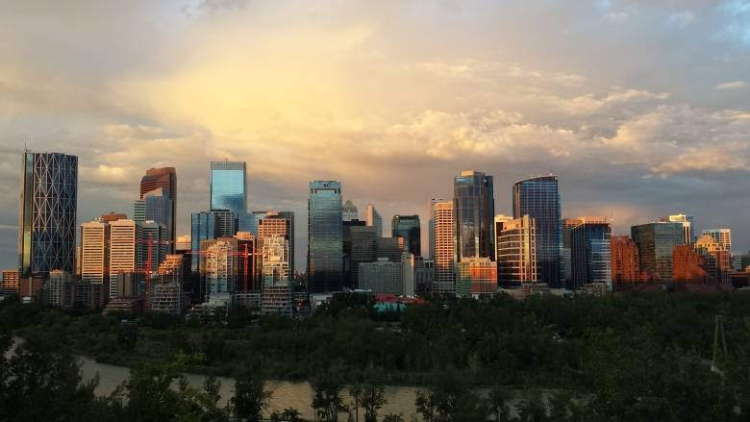
Research project aims to launch oilpatch professionals on fresh career paths
Program sets aside the old-fashioned resume to focus on what people really know, can do and understand
Tony Seskus · CBC News · Posted: May 02, 2018 4:00 AM ET | Last Updated: 8 hours ago
Many offices in downtown Calgary emptied out when the economy turned sour. Now a new research project aims to help oilpatch professionals find new careers. (Leslie Kramer/CBC)

Slide 20
Salesmanship Thinking outside the box
Belief in your ability to succeed Tenacity
Risk Taking Vision Motivation
Creativity Valuing opportunities Perseverance
Mobilizing resources Coping with ambiguity
Learning from experience Working with others

Slide 21
Charts here

Slide 22
Notes:
.

Slide 23
Discussion
How will all this help you as you work today and in the future?
What else do you need to assist you to adapt?
What message would you like us to take to policy makers?

Slide 24
jeff@griffiths-sheppard.com 403 374 1950
lane@cwf.ca 403 990 5924

Slide 25
Copy goes here
Copy goes here here
Copy goes here
Copy goes here here
Copy goes here
Copy goes here here

