Slide 1
Preparing for Life After High School: What Works? RIGOROUS EXPERIMENTATION WITH APPROACHES TO IMPROVE POSTSECONDARY OUTCOMES
Reuben Ford, PhD
Alberta Career Development Conference, Edmonton, 1 May 2015

Slide 2
Agenda
Learning What Works: the why and how of helping youth engage in decision-making about life after high school
Rigorous evidence gathering and evaluation provides much needed knowledge about what works best with whom
With limited time, focus on three approaches tested in BC, Manitoba, Ontario and New Brunswick (186 schools)
Experiments illustrate the importance of building in developmental sequencing to accommodate how youth align themselves with their future opportunities

Slide 3
Improving the match of youth to their career yields
economic efficiency and social inclusion
Increasing the number of youth whose skills align with labour market needs is ...
an effective means to promote social inclusion and to reduce social and health inequalities
an economic imperative (promoting growth, innovation and competiveness as the population ages)

Slide 4
Approaches to enhance decision-making: act earlier to change students’ education directions
Act earlier, before youth leave high school
Test interventions that legitimize and support postsecondary transitions:
Affordability
Better information and skills to access & process it effectively
Academic preparation
Simplify the decision making process: complexity puts people off!
Make preparing for the future matter
Make preparing for the future easier to do
But how?
Many new approaches being implemented and evaluated in Canada:
Learning Accounts; Pathways to Education; AVID; Explore Your Horizons; Needs Assessment Simplification; Raising the Grade; Life After High School.
No direct relationship between effectiveness in changing outcomes and expenditure per student.

Slide 5
Different intervention pathways to increase access to PSE being investigated by SRDC
Grades 9-12
Future to Discover:
Explore Your Horizons eMentoring
Learning Accounts
Raising the Grade
Grade 12
Life After High School
Grades 9-12
AVID
Financial confidence
Career Education
Simplify
Academic upgrading

Slide 6
Life After High School: AN INNOVATIVE APPROACH informed by THE “NUDGE” LITERATURE IN behavioural economics

Slide 7
Simplify approach by removing barriers for all students to complete both postsecondary and aid applications during the Grade 12 year
Making application to college or university a default Grade 12 activity may:
overcome inertia (status quo bias) and complexity bias that holds some students back in making decisions about their future
increase the salience of postsecondary education as a destination all students can aspire to (bandwagon effect)
accelerate students’ options to take up postsecondary and leave their options open: on the way out of high school, in trying to decide what to do next, decision to go to PSE only involves deciding to show up (availability heuristic)

Slide 8
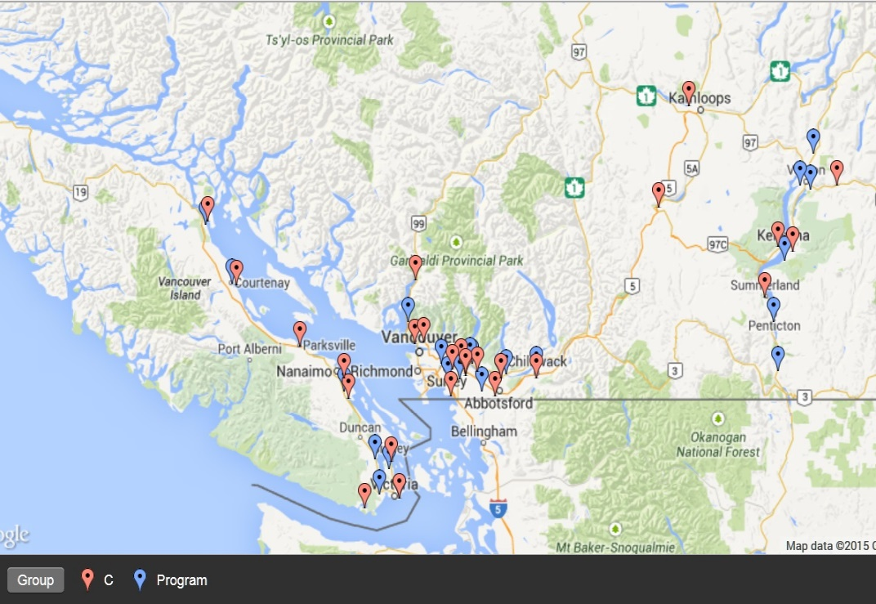
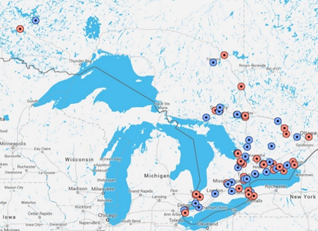
From theory to application 2010-2014
Facilitated workshops conducted in classroom during Grade 12 using online tools and video to make preparing for PSE matter and easier to do
Schools with low transition rates: half the high schools (50 in BC; 86 in Ontario) are randomly assigned to act as ‘controls’ in the experiment

Slide 9
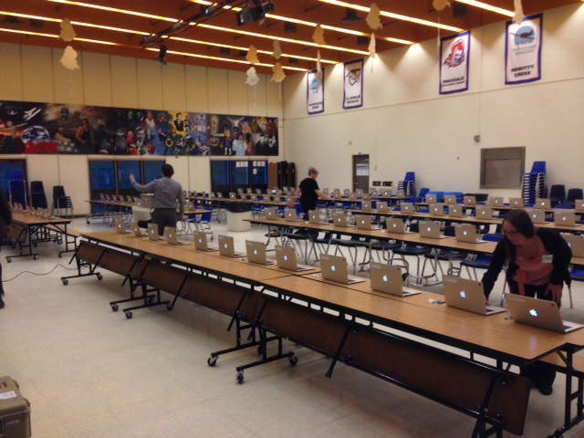
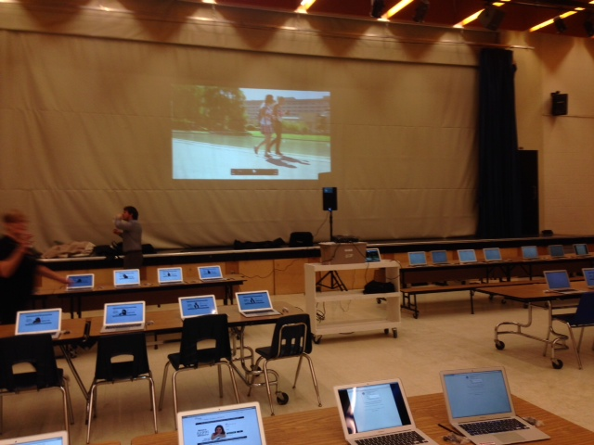
Three workshops during class time, in front of a computer
Workshop 1: Late Oct to mid-Nov
Introduces LAHS, creates LAHS student accounts
Students browse PSE programs and calculate financial aid eligibility; map out a budget
Workshop 2: Mid-Nov to mid-Dec
Prepare and submit real program applications
Application fees [up to $150] paid
Workshop 3: April to May
Prepare student aid applications

Slide 10
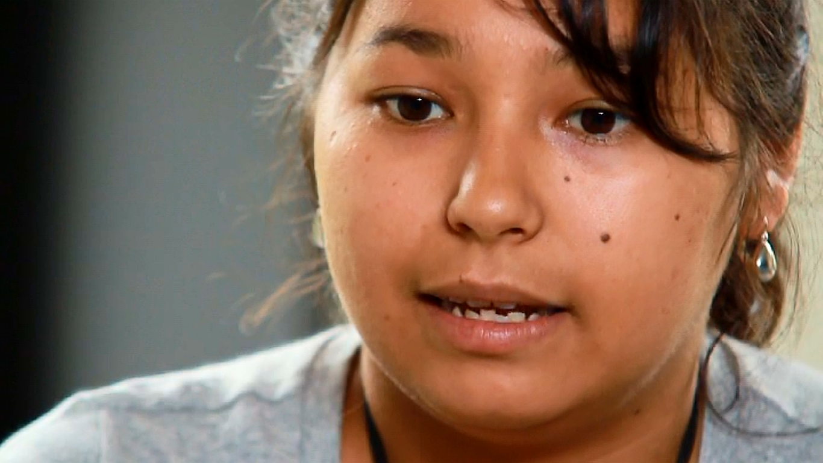
Multiple tutorial videos for youth and parents

Slide 11
Educator testimonies from Ontario
This has been so great for our kids. I wish you could see the neighbourhood – there are boarded up houses all over the place – for them to hear, ‘ you have potential, you can do this.’ And when they saw the OSAP calculation, and realized, ‘I can do this,’ you should see their faces light up.”
I just had a Grade 12 student walk up to me in the halls and say: Guess what? I just got accepted by Fleming College! There was a big package in the mail and my Mom told me to open it last night. I asked (him) if you didn’t participate in the LAHS Program would you have applied to college? (He) answered, probably not.
We went through the process as a group, so a sense of community, ‘we’re in this together’ mindset was established – this provided some encouragement for our reluctant (less confident) students as well.
LAHS kick-started kids into thinking about postsecondary options and created more ‘buzz’ about PSE than in previous years; created an exciting atmosphere around postsecondary options; students researched and asked relevant questions about PSE; everyone knew what LAHS was about…
LAHS reduced students and parents anxiety about applying to PSE and OSAP…

Slide 12
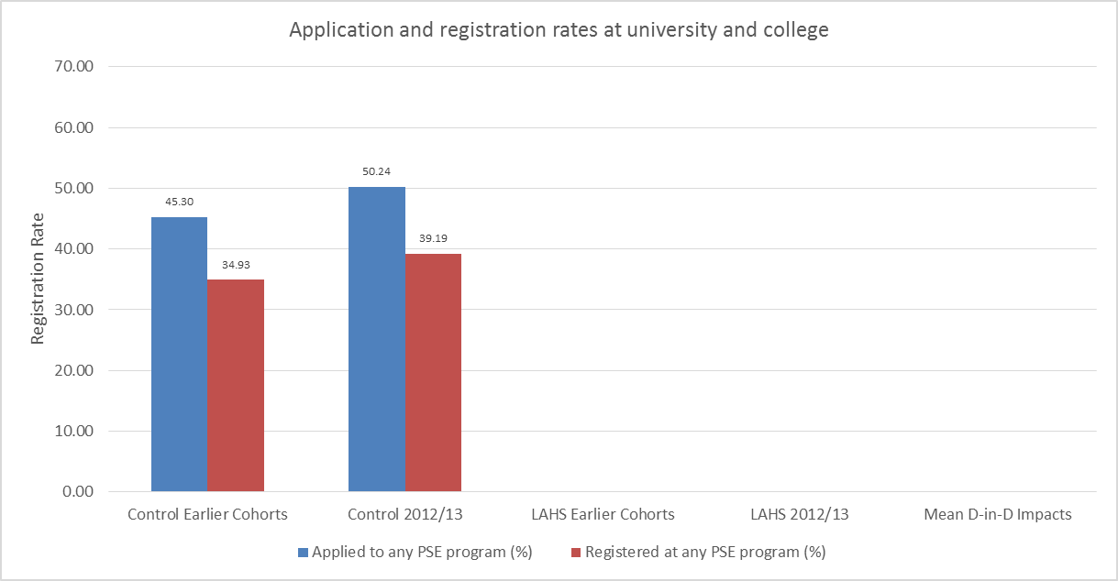
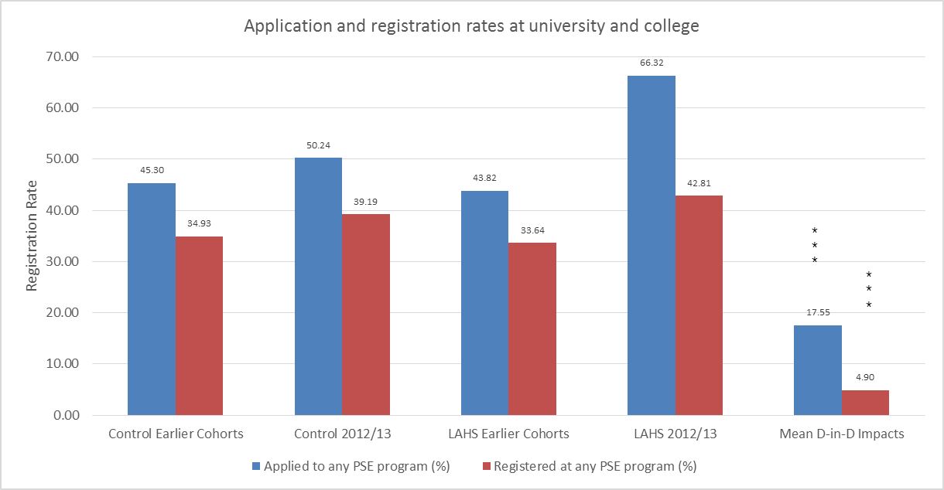
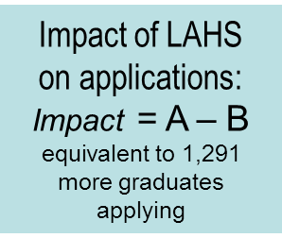
Life After High School raised postsecondary application and registration rates significantly
A
B

Slide 13
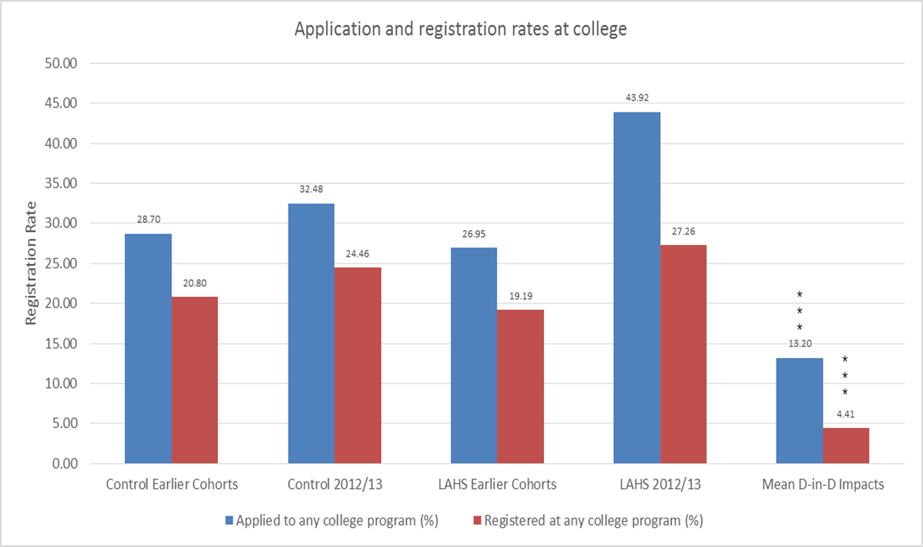
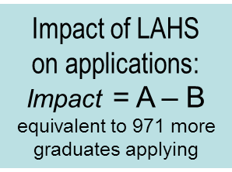
Life After High School raised community college application and registration rates significantly
A
B

Slide 14
On average, each school had 24 more students receiving an offer of a place in college, and 9 more taking it up
Counts of students | Without LAHS | LAHS added
Number of Grade 12 | 263.9 | 0.0
Number of Graduates | 161.8 | 0.0
Applicants to College | 66.4 | +25.2
Offers of acceptance | 60.2 | +23.5
Applied, no offer | 6.3 | +1.6
Took offer | 46.1 | +8.6
Counsellor: “I think the Pay for Free option and the forced workshop attendance allowed some students the opportunity to go to PSE. Many students had planned to come back for year 5 but then were surprised when they received an acceptance to PSE.”

Slide 15
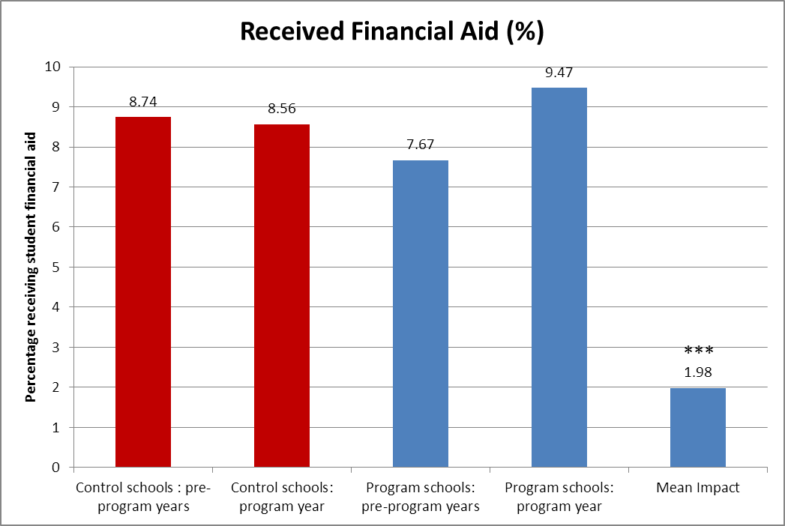
Insufficient data for analysis of impact on OSAP. In BC, LAHS increased receipt of student financial aid.
83 per cent of educators agreed that students found Workshop 3 helped them increase their understanding of OSAP
86 per cent agreed that it helped them to apply for OSAP.

Slide 16
Scaling up Life After High School?
Even with lower compliance than hoped for and no changes in secondary or postsecondary education programs on offer, increasing applications to university and college can produce significant changes in behaviour and outcomes:
Nearly all the extra applicants in Ontario received offers, not rejections.
One in every three extra applicants enrolled in PSE
There are many options to adopt elements of the approach:
Mandatory classes to build applications
Take applications as far as possible even if not submitted in class
Establish awareness of available aid early
Online video to support process
Simplified program selection

Slide 17
FUTURE TO DISCOVER: TESTING TWO ALTERNATIVE EARLY APPROACHES TO INCREASE PARTICIPATION IN POSTSECONDARY EDUCATION

Slide 18
Future to Discover tested two interventions separately and in parallel
EYH: Explore Your Horizons Enhanced early career education in Grades 10, 11, and 12
LA: Learning Accounts Early guarantee of $8,000 grant to pursue PSE for lower-income students
Notes:
Goal: To develop evidence about what works to increase access to PSE in Canada, particularly for young people from families with lower incomes or with little or no experience in PSE, or both.
Large-scale demonstration project with over 5,400 high school students, operating in 51 schools in Manitoba and New Brunswick provinces
Partnership between the Canada Millennium Scholarship Foundation and the Governments of Manitoba, and New Brunswick.
SRDC contracted to undertake rigorous evaluation

Slide 19
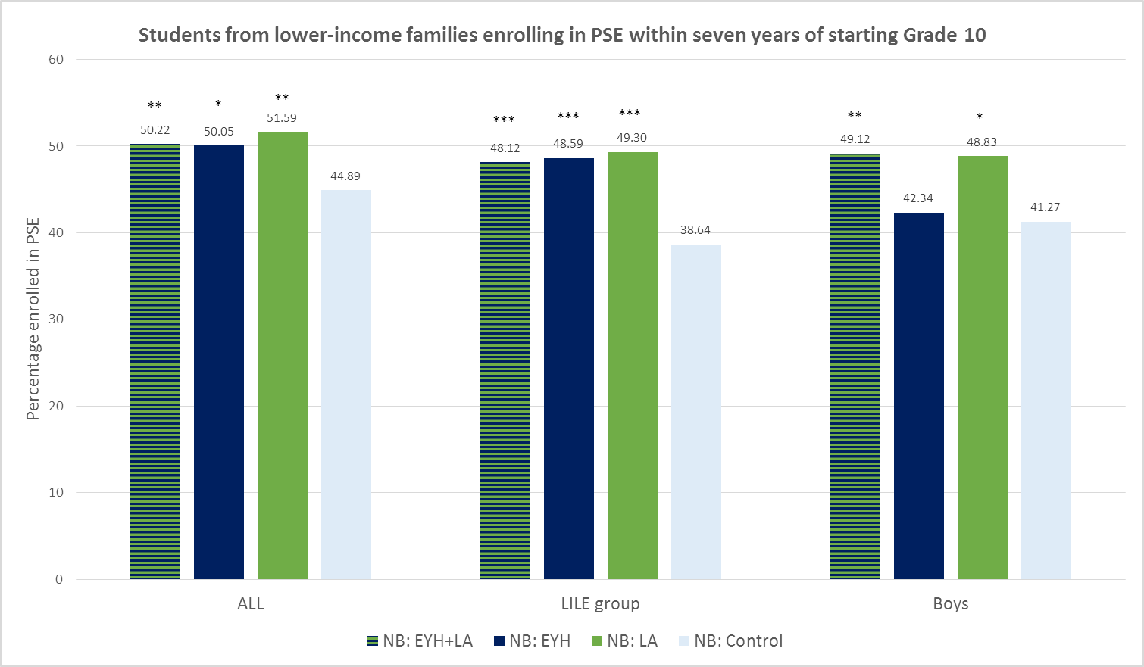
EYH and LA increased PSE enrolment rates by up to 10 percentage points
Notes:
PSE=university and college

Slide 20
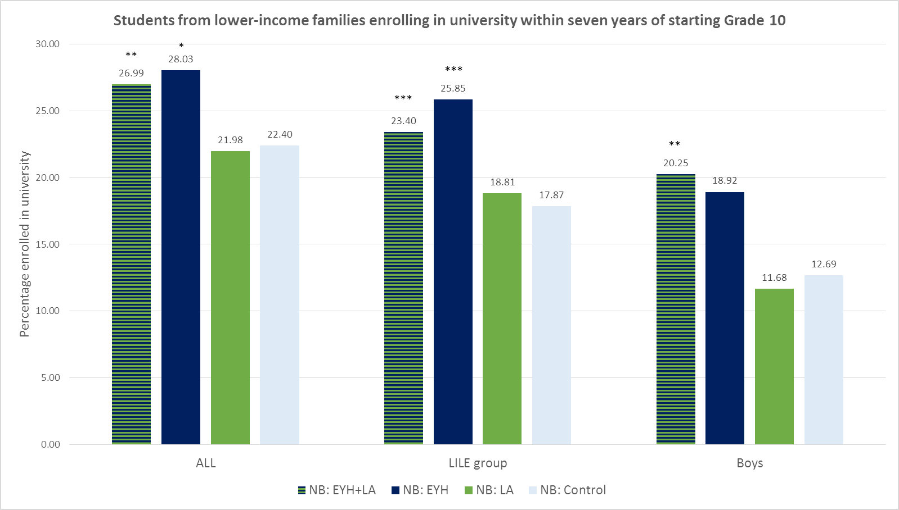
EYH and EYH+LA increased university enrolment rates by up to 8 percentage points

Slide 21
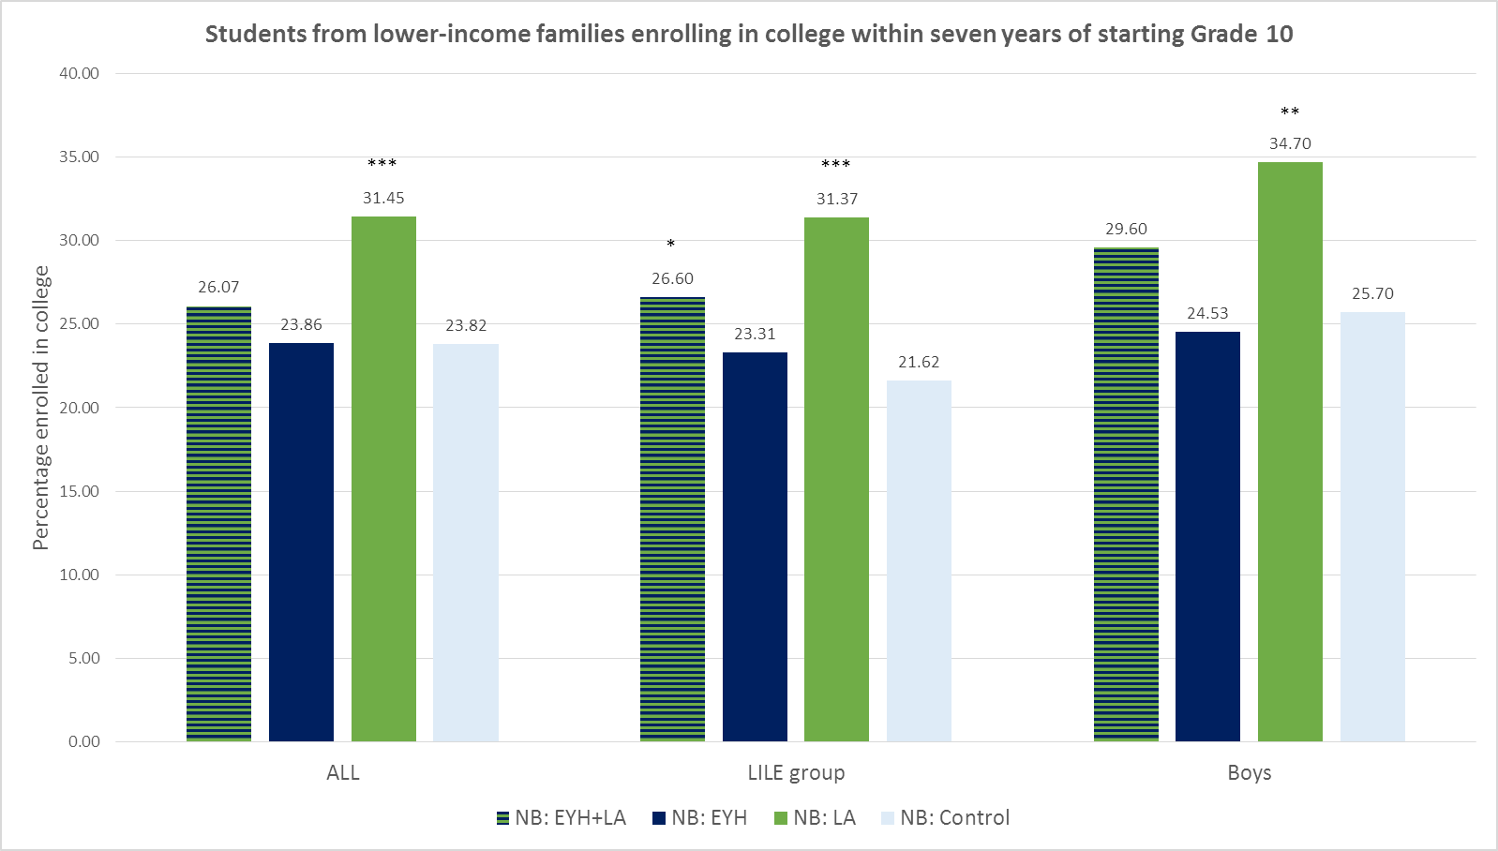
LA increased college enrolment rates by up to 9 percentage points

Slide 22
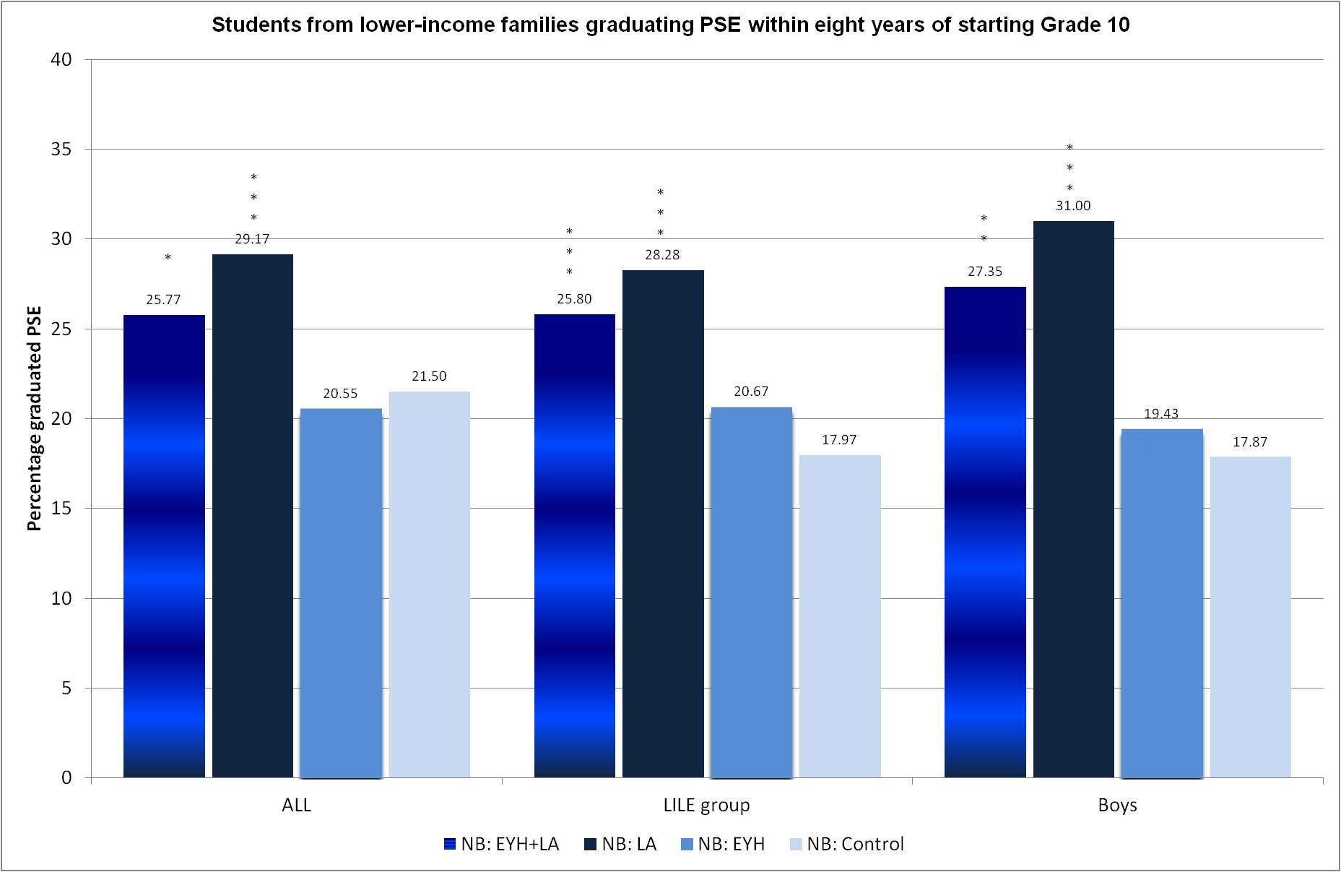
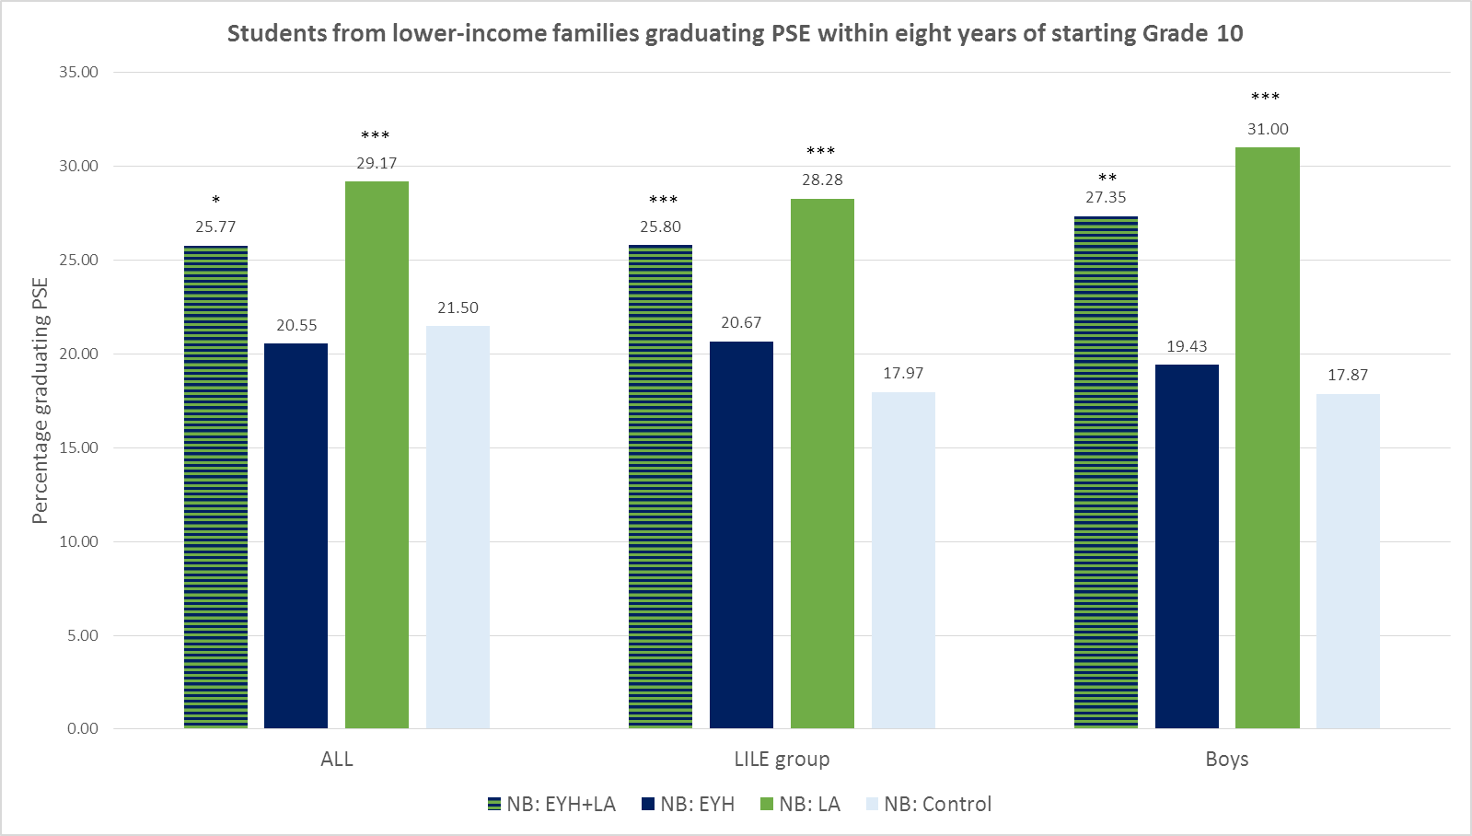
EYH+LA and LA increased PSE graduation by 2014 by 8-13 percentage points

Slide 23
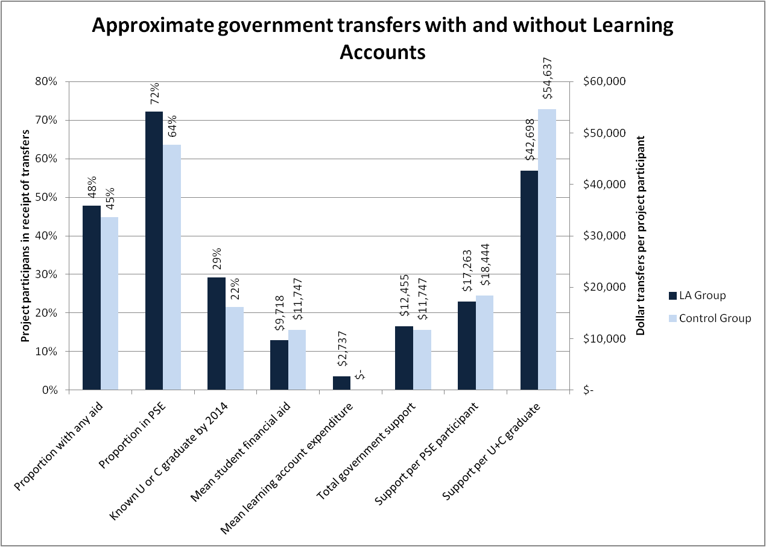
LA requires lower government transfers per postsecondary student and substantially lower per 2014 graduate
Notes:
LA decreased the amounts received for parents with any PSE (-$2,411 ), girls (-$3,721) and Anglophone (-$2,895)

Slide 24
EYH increased apprenticeships in Manitoba among non-traditional students

Slide 25
LA increased apprenticeships in New Brunswick among non-traditional students

Slide 26
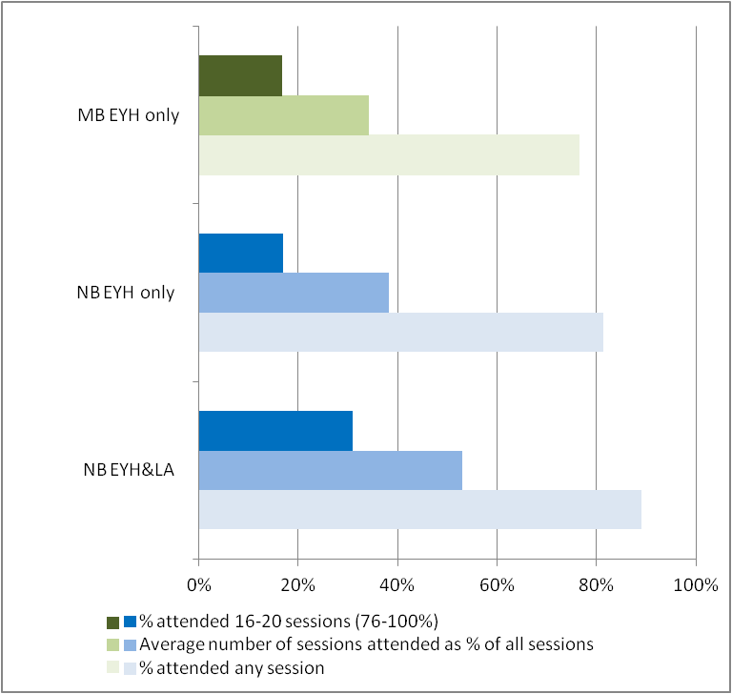
Unlike LAHS, EYH and LA were not mandatory. The impacts occurred despite low exposure to the treatment
EYH participation declined from Grade 10 through Grade 12.
Survey in Grade 12 found low awareness among LA holders of their status. Higher among francophone students.

Slide 27
FTD: take aways to date
Youth can be sensitive to reasonably modest interventions to make potentially major changes in their lives:
Among the ‘same’ NB students, EYH and EYH+LA increased university enrolment. LA increased college enrolment.
Broad ‘unbiased’ career exploration promotes atypical PSE pathways, e.g. into apprenticeships
Interventions typically increase duration of education for boys.
Zero effects on leaving PSE and only modest on switching institutions.
LA is forecast to be very cost effective, generating $2+ benefit per dollar cost to government.

Slide 28
LAHS: take aways to date
“Nudge” programs can be popular and effective in
Engaging all youth: mandatory participation to learn about PSE options
Popularizing planning for the future: changing social norms on whom postsecondary education is for. Also possibility for peer effects, spillover.
Simplifying: accessible messaging and step-by-step decisions through workshops in class with opportunities for catch up through video tutorials.
Reassuring: guidance from trusted partner/agent provide reassurance that the full process of PSE application and student aid application will be covered.
Empowering: supporting students’ own activity and investment leads to encouragement, interest, and motivation.

Slide 29
Building on the evidence: a new approach
to enhance and accelerate informed postsecondary decision making
Early guarantee of aid
No conditions on type of PSE
Mandatory
Online account
Linear classroom activity
Removal of fees
Unbiased career education support
Developmental progression
Simplify
Financial confidence
Career education
Grade 9
Online portfolio creation/exploration
Delivery of aid guarantee
Grade 10
Refining & prioritize postsecondary choices
Grades 11-12
Finalize default applications
Develop interests and prerequisites through course choices
Automatic program application
Automatic aid application
Postsecondary budgeting

Slide 30
Aligning student choices with future economic realities
A proposal for a new in-class, evidence-based program
Engage all youth in a series of regular high school classes focused on online career exploration...
to record key decisions on their postsecondary aspirations,
leading up to automated applications, and
for lower-income students with the reassurance of an aid guarantee.
Featuring…
Mandatory participation
Earlier scheduling of determination of assistance
Centre activity around a single portal and database
Automate applications
Continuous availability for revisits and revision
Feedback to planning

